Slide 1
By using Chest X-ray performing pneumonia detection
Submitted in the partial fulfillment for the award of the degree of
BACHELOR OF ENGINEERING
IN
Artificial Intelligence and Machine Learning
Submitted by:
Ishika 19BCS6048
Anmol 19BCS6069
Asmi 19BCS6078
Jai 19BCS6089
Ayushi 19BCS6065
Under the Supervision of:
Ms Pooja Verma
DISCOVER . LEARN . EMPOWER
Department of AIT-CSE

Slide 2
Outline
Introduction to Project
Problem Formulation
Objectives of the work
Methodology used
Results and Outputs
Conclusion
Future Scope
References

Slide 3
Introduction to Project
Pneumonia is a lung infection, which can be caused by either bacteria or viruses.
More than 1 million adults are hospitalized with pneumonia and around 50,000 die from the disease every year in the US alone. Pneumonia is considered the greatest cause of child fatalities all over the world.
Luckily, this bacterial or viral infectious disease can be well treated by antibiotics and antivirals drugs.
Nevertheless, faster diagnosis of viral or bacterial pneumonia and the consequent application of correct medication can help significantly to prevent deterioration of a patient’s condition, which eventually leads to death.

Slide 4
Introduction to Project
Chest-X rays are currently the best available method for diagnosing pneumonia, which play a crucial role in clinical care and epidemiological studies.
However, detecting pneumonia in Chest-X rays is a challenging task that relies on the availability of expert radiologists.
To ease this problem, we can develop a model that can automatically detect pneumonia from Chest-X rays at a level exceeding practicing radiologists, giving machine the intelligence to provide accurate results.

Slide 5
Problem Formulation
Pneumonia detection using chest X-rays has been an open problem for many years, the main limitation being the scarcity of publicly available data. Traditional machine learning methods have been explored extensively.
An optimal algorithm for pneumonia detection from Chest X-rays is proposed in this project. Data augmentation techniques were deployed to increase the size of the limited dataset.
CNN models are feed-forward networks with convolutional layers, pooling layers, ﬂattening layers and fully connected layers employing suitable activation functions.

Slide 6
Objectives of the Work
The proposed work is aimed to carry out work leading to the development of an approach for detecting pneumonia using chest x-rays. The proposed aim will be achieved by dividing the work into following objectives:
First developing the deep learning model to detect pneumonia using the convolutional neural networks. The main libraries used here are tensorflow and keras.
Now, second part is making the model available through a website which is done using flask which is a web framework for python.
At last, the model is deployed and the website is created for use.
Now, html and css can be used to make the website presentable and look good.

Slide 7
Methodology used
The methodology and approach we’ve used is described step by step ahead:
We have preprocessed all the data and the X-ray images were cropped to the ideal dimensions for computational needs.
Next, we uploaded the data in the memory.
Then we created a callbacks function and model checkpoint.
Next, we reshaped the data and created the model through CNN. And last we did model fitting and found the accuracy and value loss using confusion matrix.

Slide 8
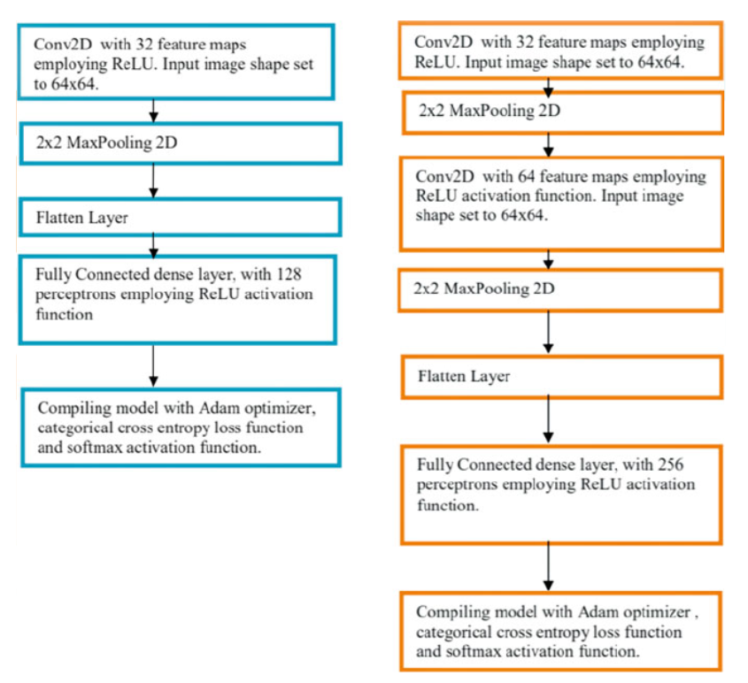
Methodology Used

Slide 9
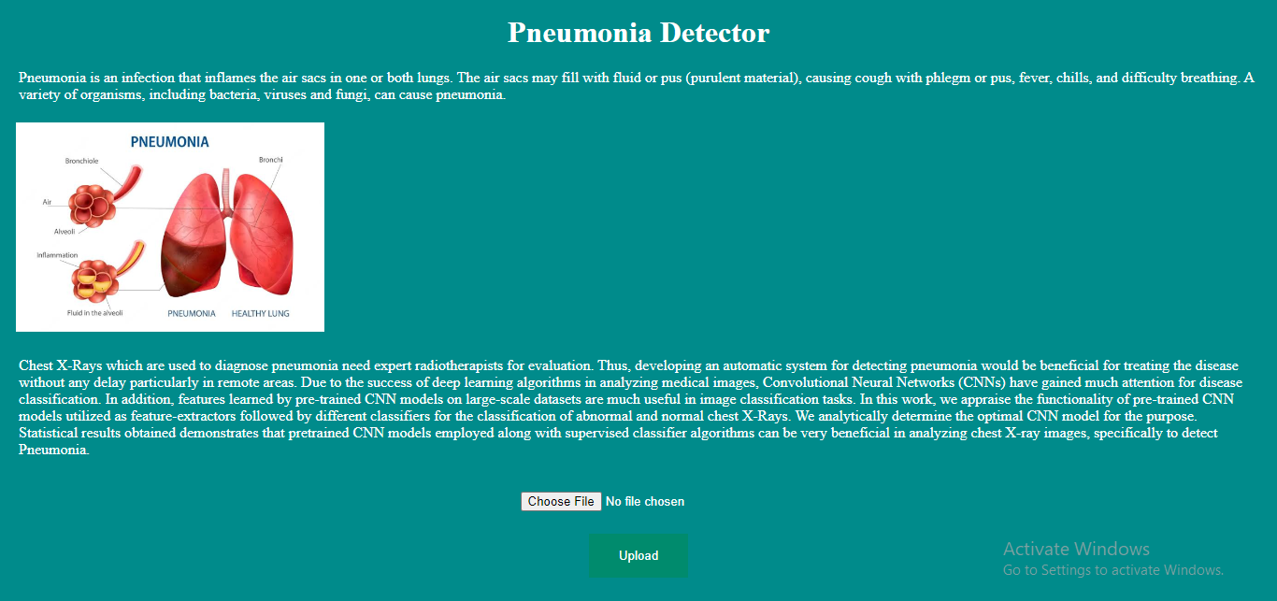
Results and Outputs

Slide 10
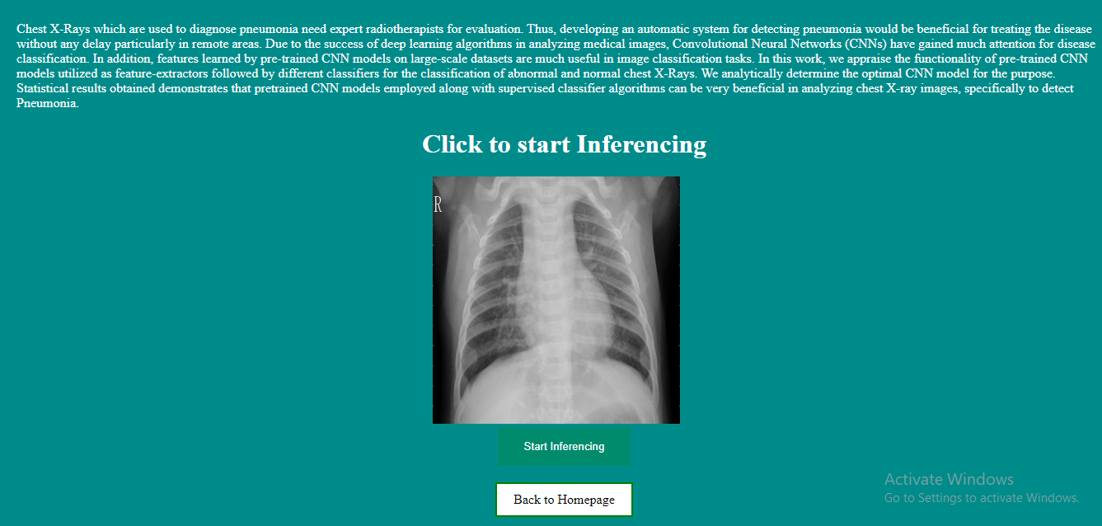

Slide 11
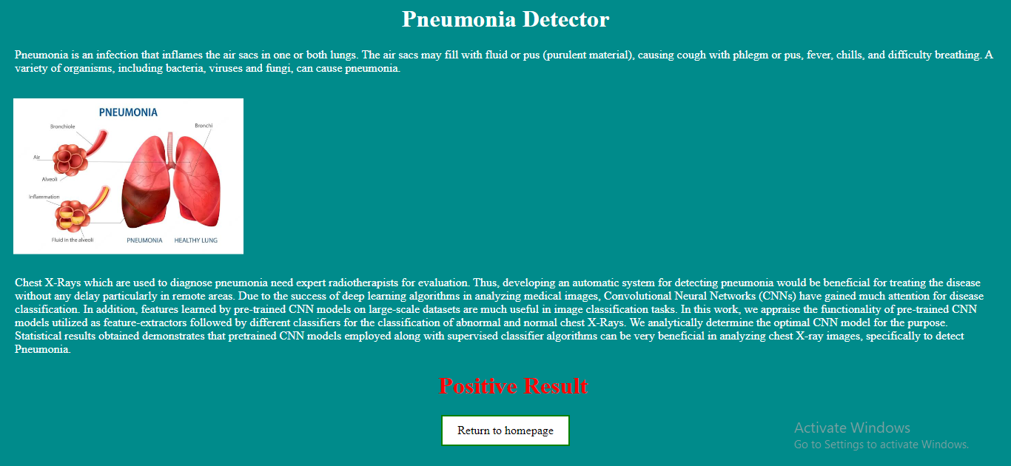

Slide 12
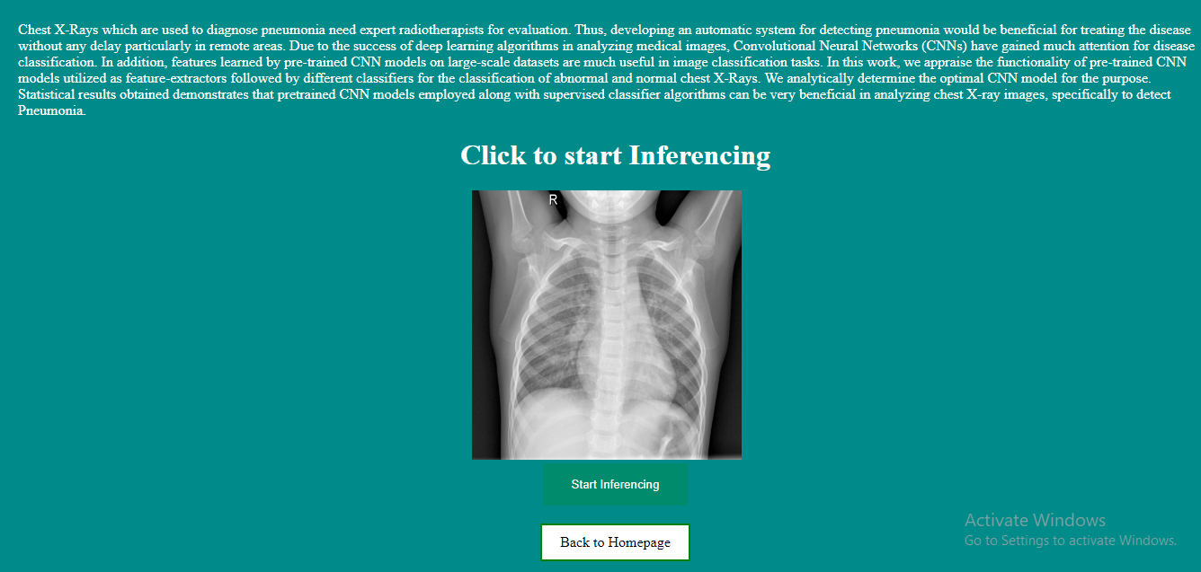

Slide 13
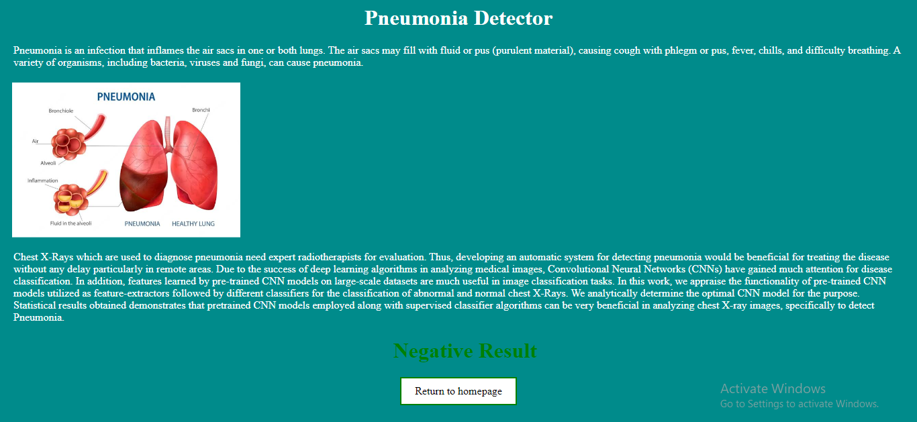

Slide 14
Conclusion
Chest radiography has played a vital role in the examination and diagnosis of chest diseases. Thus, automatic detection has become a popular topic in computer vision research for medical imaging.
Many algorithms using various techniques have been developed to detect chest diseases.
Detection of diseases with the assistance of computers from various Machine and Deep learning techniques are very beneficial in such places where there is shortage of people who are skilled in techniques like radiology.
Our project successfully provides with a CNN based approach for detection of pneumonia automatically and easily.

Slide 15
Future Scope
Pneumonia constitutes a significant cause of morbidity and mortality. It accounts for a considerable number of adult hospital admissions, and a significant number of those patients ultimately die.
Even when there is the availability of imaging equipment, there is a shortage of experts who can examine X-rays.
A lot of people die without even knowing they have pneumonia.
So in future if we are able to detect pneumonia automatically using chest x-rays only and that with a lot of accuracy, we can save a lot of lives.

Slide 16
References
[1] Agarwal, V., Green, T. C., & Ren, H. (2018). Alpha or beta in the eye of the beholder:
Whatever drives hedge fund flows? Journal of Financial Economics, 127 (3), 417–434.
[2] Aggarwal, R. K., Krigman, L., & Womack, K. L. (2002). Strategic ipo underpricing, information momentum, and
lockup expiration selling. Journal of financial economics, 66 (1), 105–137. Bacidore, J. M., & Sofianos, G. (2002).
[3] Liquidity provision and specialist trading in nyse-listed non-us stocks.
Journal of Financial Economics, 63 (1), 133–158.
[4] Becker, C., Ferson, W., Myers, D. H., & Schill, M. J. (1999).
[5] Conditional market timing with benchmark investors. Journal of Financial Economics, 52 (1), 119–148.
[6] Brown, G., Harris, R., Hu, W., Jenkinson, T., Kaplan, S. N., & Robinson, D. T. (2021).
[7] F. Q. Lauzon, ‘‘An introduction to deep learning,’’ in Proc. 11th Int. Conf. Inf. Sci., Signal Process.
Appl. (ISSPA), 2012, pp. 1438–1439
[8] E. Ayan and H. M. Unver, ‘‘Diagnosis of pneumonia from chest Xray images using deep learning,’’
in Proc. Sci. Meeting Elect.-Electron. Biomed. Eng. Comput. Sci. (EBBT), Apr. 2019, pp. 1–5.

